Slide 1
Efficient Machine Unlearning for Deep Neural Networks
Project By: Dev Divyendh Dhinakaran
G01450299

Slide 2
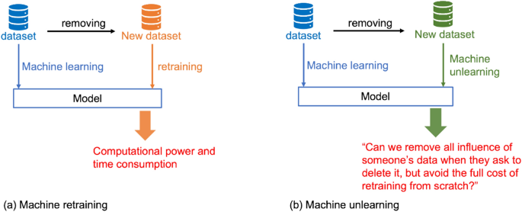
So, What is Machine Unlearning?
a technique that allows machine learning models to "forget" or remove specific data points without retraining the entire model

Slide 3
Objective
To design and implement hybrid unlearning strategies that balance selective forgetting and retention while maintaining overall model generalization.
Idea…….
NeurIPS 2023 Machine Unlearning Challenge

Slide 4
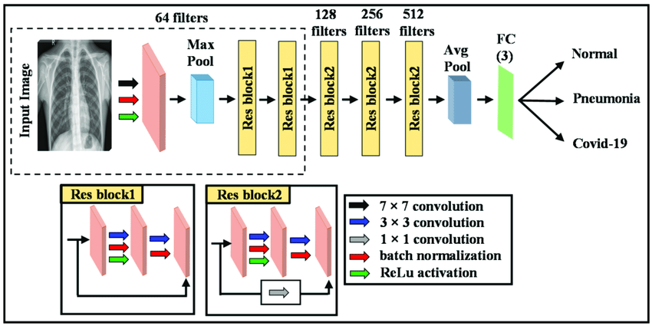
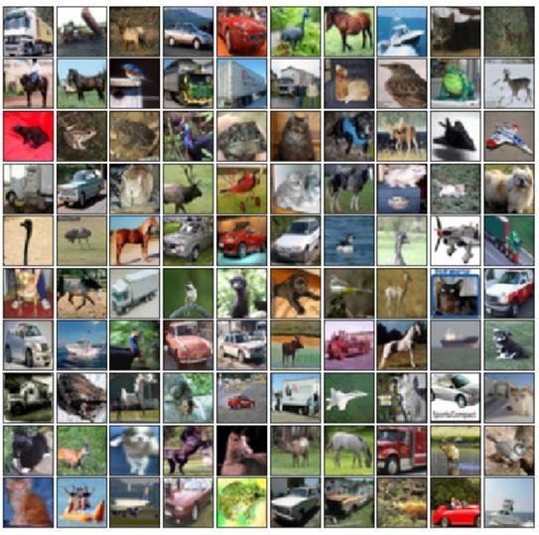
Model and Dataset
ResNet18
CIFAR-10 Dataset

Slide 5
My Approach…
Model 1: Fine-tuning only on the retain set.
Model 2: Selective fine-tuning
Model 3: Fine-tuning with gradient reversal
Model 4: Alternating fine-tuning and gradient reversal
Model 5:Frequent alternation with stronger gradient reversal
Model 6: Frequent alternation with final fine-tuning
Hybrid 1: Dynamic Reverse Scalar Factor
Hybrid 2: Type 2 (DRSF) with Final Tuning
Hybrid 3: Improved Factor
Hybrid 4: The Final Model
DATA
Retain set
90%
Forget Set
10%

Slide 6
Model 1 – Fine Tuning on Retain set
Inspired by the example provided in the competition’s starter code.
Fine-tunes the pretrained ResNet-18 solely on the retain set with
DATA
Retain set
90%
Forget Set
10%

Slide 7
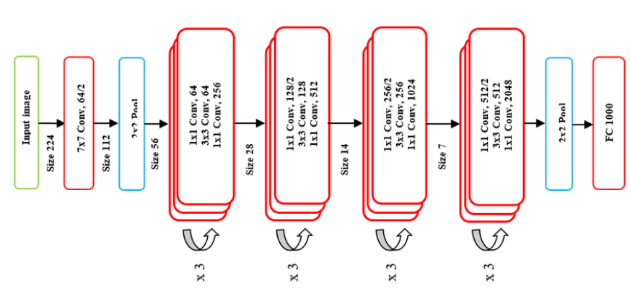
Model 2 - Selective Fine-tuning
This model fine-tunes only the last layers (Layer 4 and FC) of the model on the retain set, freezing all other layers to preserve previous learned knowledge (Make model more Generalized).

Slide 8
Model 3 - Gradient Reversal Unlearning
This model fine-tunes on the retain set, then applies gradient reversal on the forget set to minimize the retained knowledge on this data.
Apply during Back-propagation
Not Trying to reduce the loss function (eventually will unlearn forget set)

Slide 9
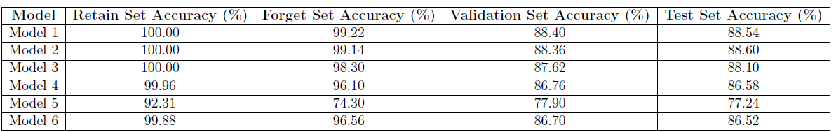
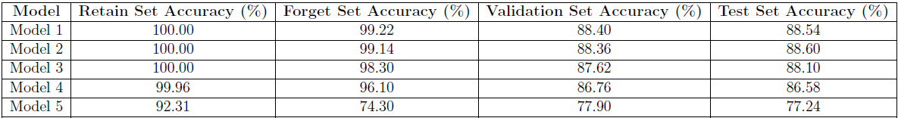
Alternating between Fine Tuning and Gradient Reversal
Model 4
Fine tuning on Retain Set
Gradient Reversal on Forget set
Every Epoch
Model 6
Model 5 + Fine Tuning over Retain set (to boost Retain set Accuracy)
Model 5
Stronger Version of Model 4 with Aggressive Gradient Reversal Factor
DATA
Retain set
90%
Forget Set
10%

Slide 10

Insights to proceed….
Hybrid Models are working Fine Tuning + Gradient Reversal
But…..
Aggressive Reverse Scale Factor, affects the Generalization of the model
Normal RSF leads to bad metrics

Slide 11
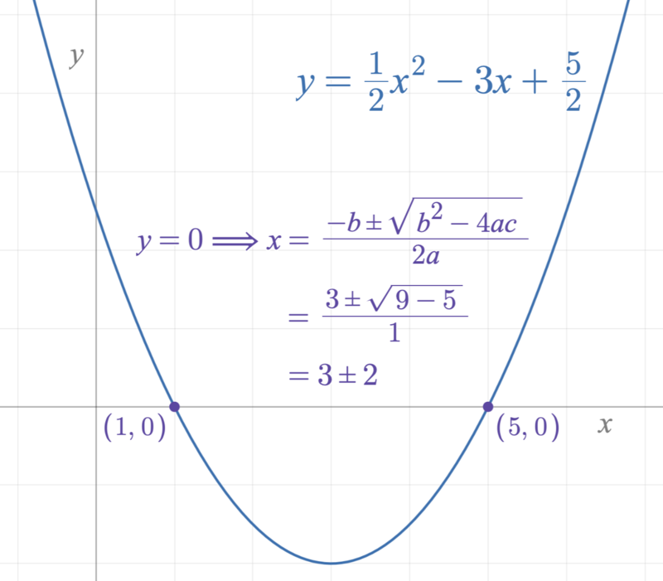
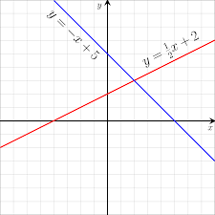
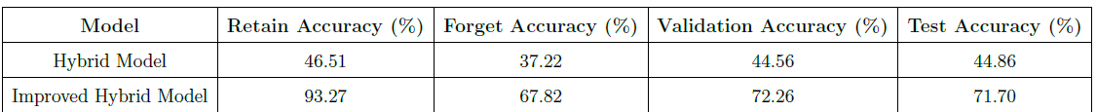
Hybrid Models – Dynamic Reverse Scaling
Hybrid Model 1
Alternating Final Tuning and Gradient Reversal
With Reverse Scaling Factor Linear
Hybrid Model 2
Hybrid Model 1 with….
Reverse Scaling Factor Quadratic
Plus Final Tuning one Last time on Retain Set

Slide 12
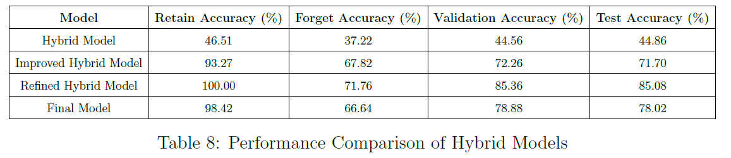
Hybrid Models – Dynamic Reverse Scaling
Hybrid Model 3
Fine Tuning on Retain Set for every fixed number of epochs (I chose 10)
Hybrid Model 4
Not to Lose the Generalization
Froze Layer 1 and 2 for first 30% of my epochs.

Slide 13
Thank You

